Slide 1

Monitoring Intrusions with
Spenser Reinhardt
https://github.com/honeyappsproject/presentations

Slide 2
Who am I?
Spenser Reinhardt (@c0mmiebstrd)
Github: commiebstrd \ sreinhardt \ honeyappsproject
Docker: commiebstrd \ sreinhardt \ honeyappsproject
Co-Founder \ Lead Developer – Honeyapps
Lead Developer \ Security Lead – Nagios-Plugins
Def Con NOC Goon
Capture the Flag Challenge Creator

Slide 3
Plan of Attack
Terminology
Where We've Been
Where We're Going
How Do Honeypots Help Improve Security Posture
How Does HoneyApps Fit in My Org
Videos

Slide 4
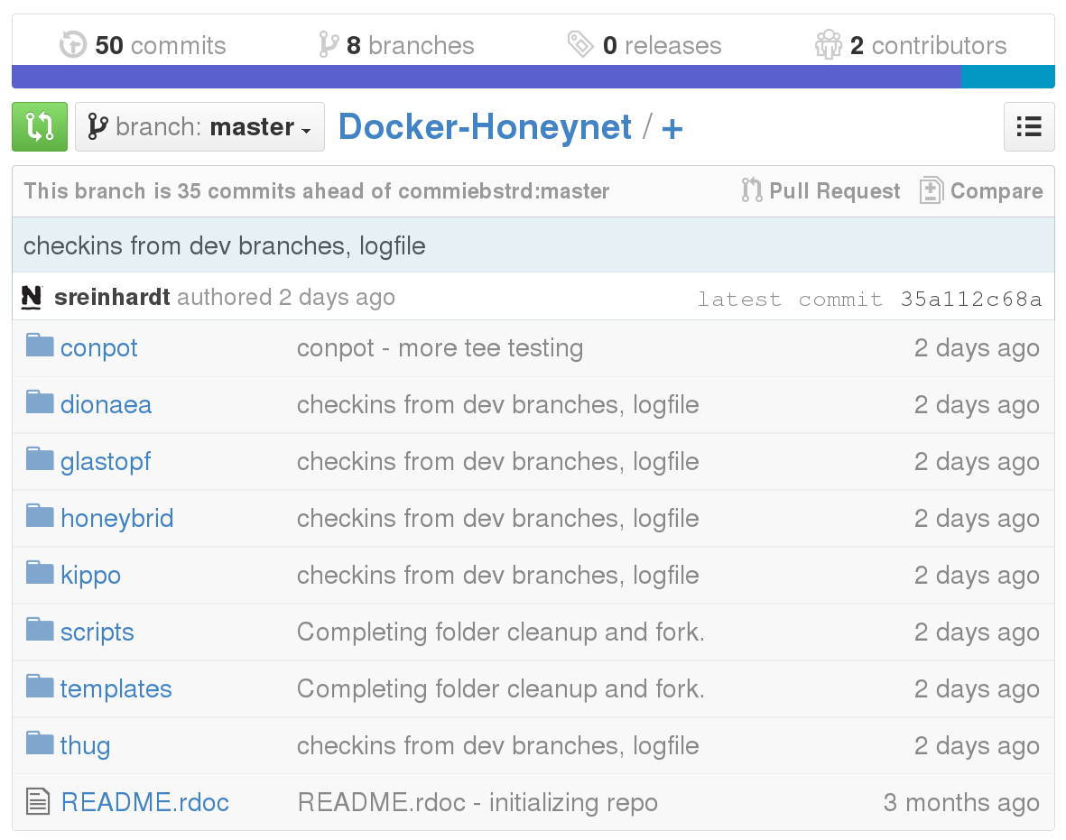
Terminology
Github – Code versioning system and storage

Slide 5
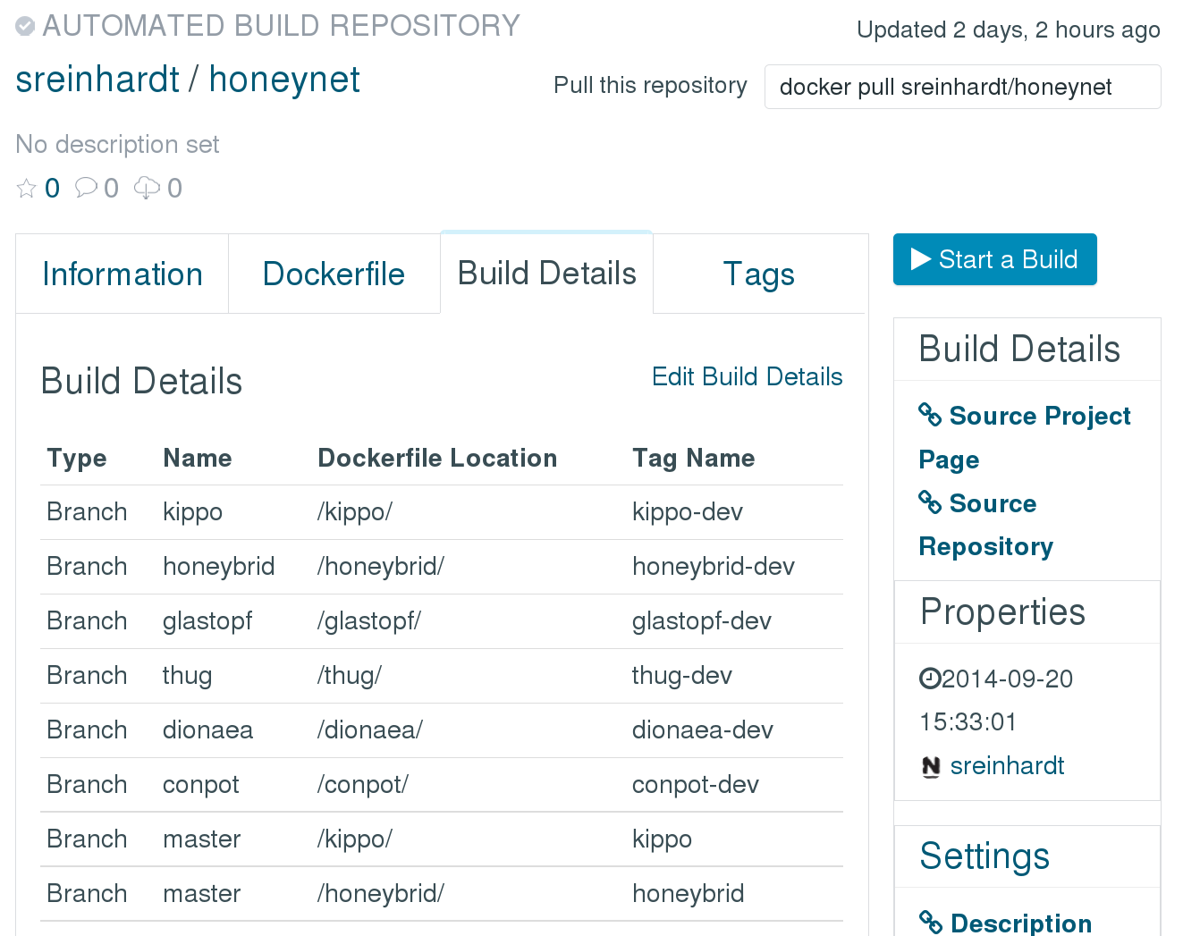
Terminology
Docker – Containerized application build and deployment

Slide 6
Terminology
Rust
Modern C\C++ replacement
Memory safety without garbage collection
Implicit immutability, explicit mutability
Rich Typesystem
Strong functional programming influence
"Rust is a systems programming language that runs blazingly fast,
prevents almost all crashes*, and eliminates data races."
* In theory. Rust is a work-in-progress and may do anything it likes
up to and including eating your laundry. Control / Performance
Safety C C++ Rust Go Java ML Haskell

Slide 7
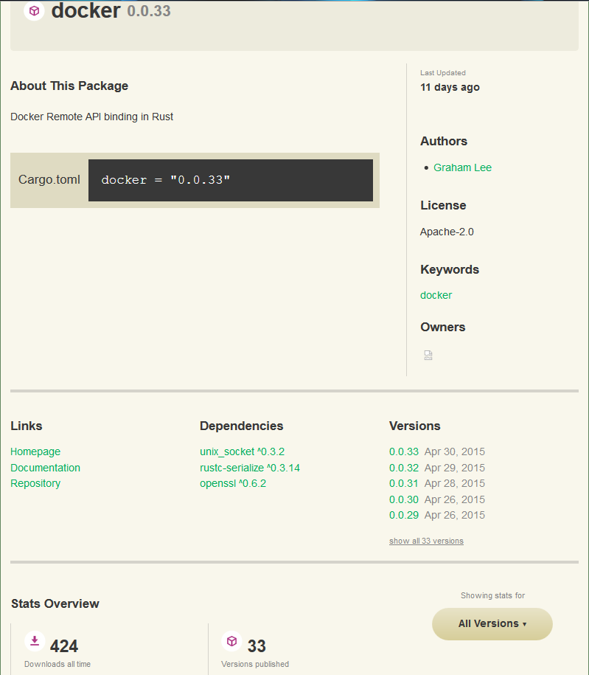
Terminology
Cargo – Automated build and dependency tracker for Rust

Slide 8
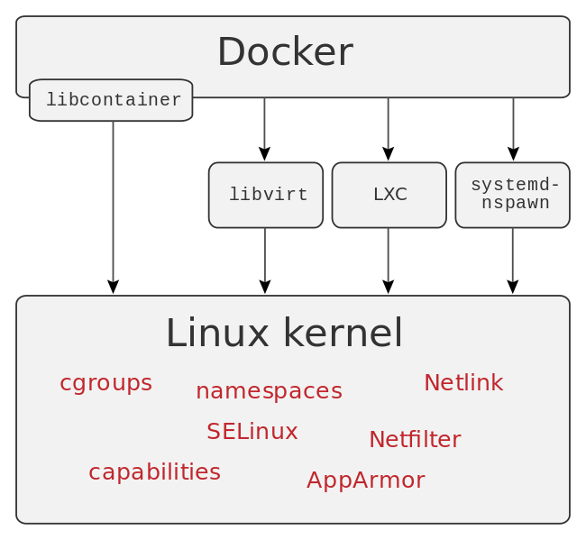
Terminology
Containers – OS level virtualization and isolation method for deploying applications.

Slide 9
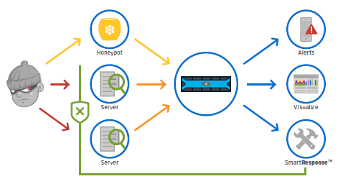
Terminology
Honeypot - System designed to attract and detect malicious actions and actors.

Slide 10
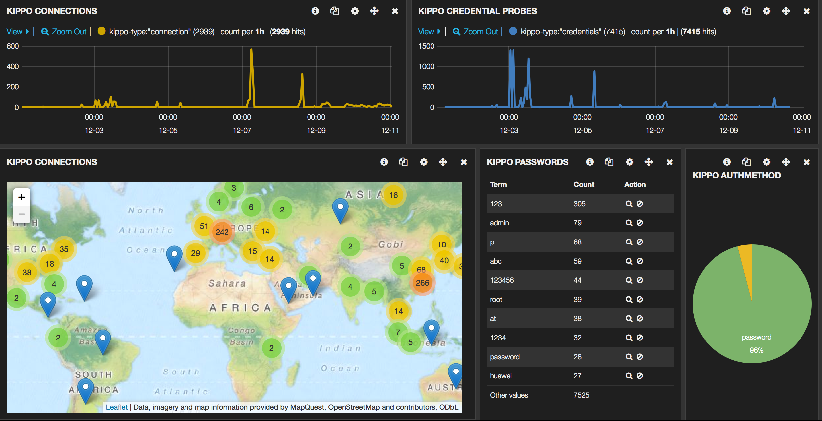
Terminology
Elk Stack – Centralized log collection and parsing, deep search, and data analytics and visualizations.

Slide 11
Where We've Been
Nagios Core – Maintain honeypots, execute remote scripts.
Nagios Log Server – Retain and visualize attack and log data.
Nagios Network Analyzer – Capture netflow traffic.
Docker – Honeypot containment and execution.
Suricata – Signature based detection of attacks.
Honeynet Project – Various honeypots.

Slide 12
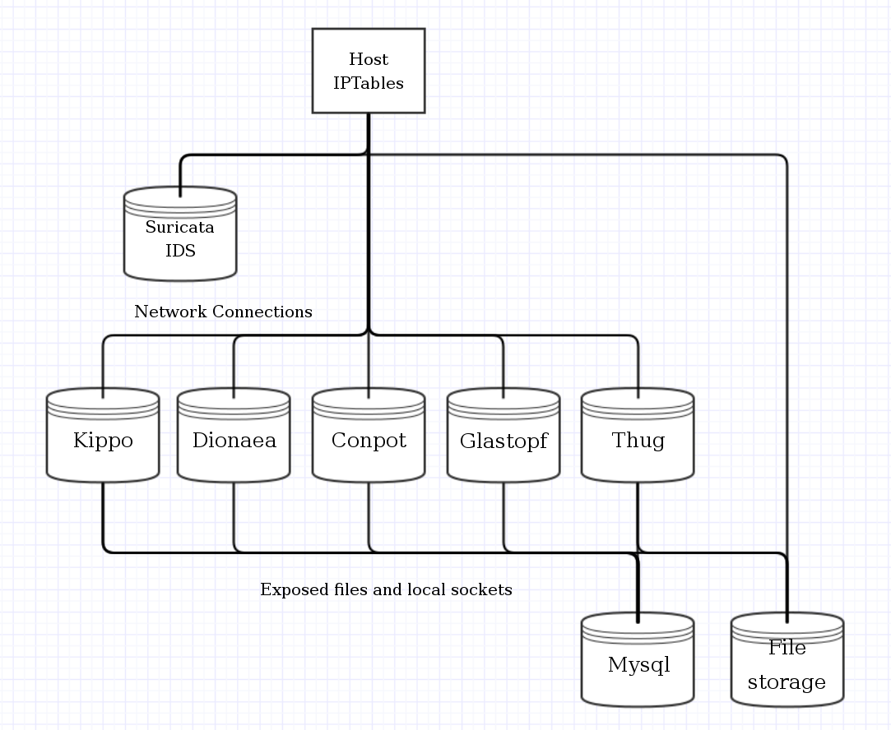
Where We've Been

Slide 13
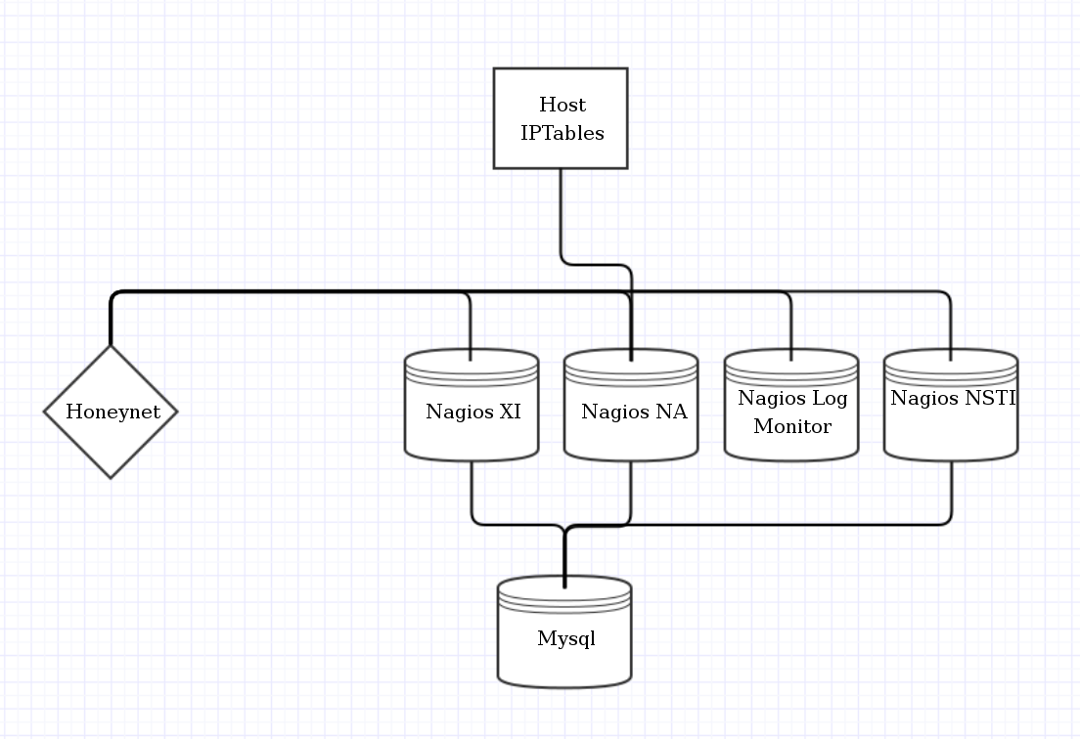
Where We've Been

Slide 14
Where We're Going
HoneyApps Director
Centralized management interface
Control, logging, honeypot daemon isolation.
Simple flat file and web interface configuration.
Memory and thread safe build language.
Repeatable build and test environments, publicly available.
Overall Project
Revert on crash honeypots.
Fast deployment with automatic configuration pushes.
Deployment via Docker containers and VMware images.
HPfeeds\HPfriends integration via native rust implementation
Integration and correlation with third-party tools. (import & export)
Enterprise supported open-source project

Slide 15
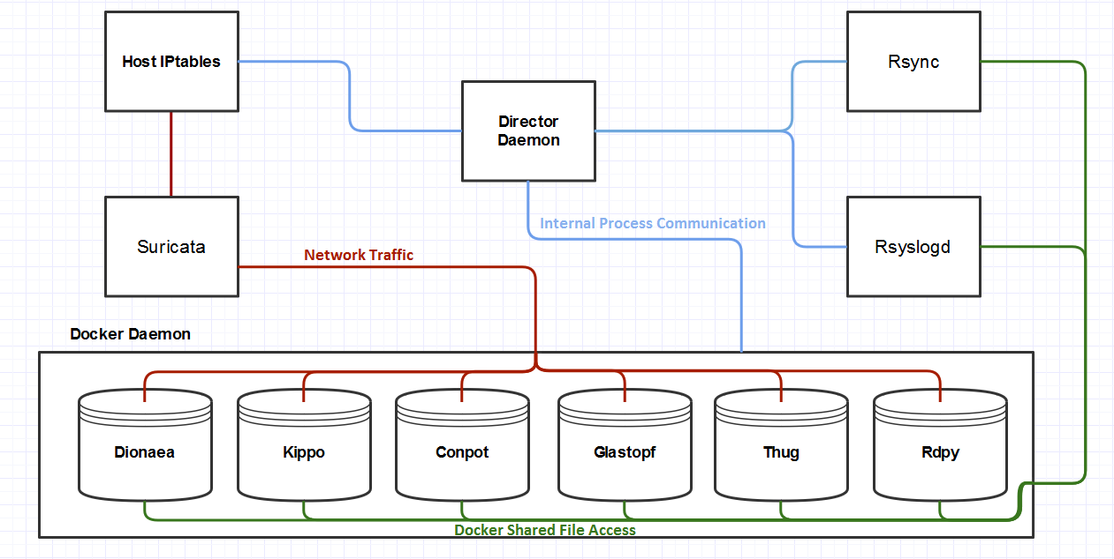
Director Worker

Slide 16
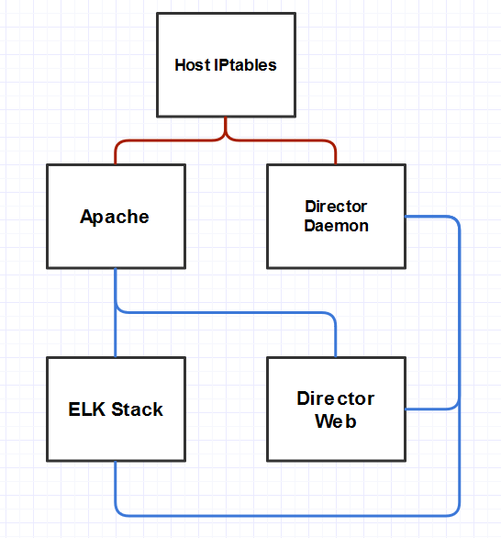
Director Primary

Slide 17
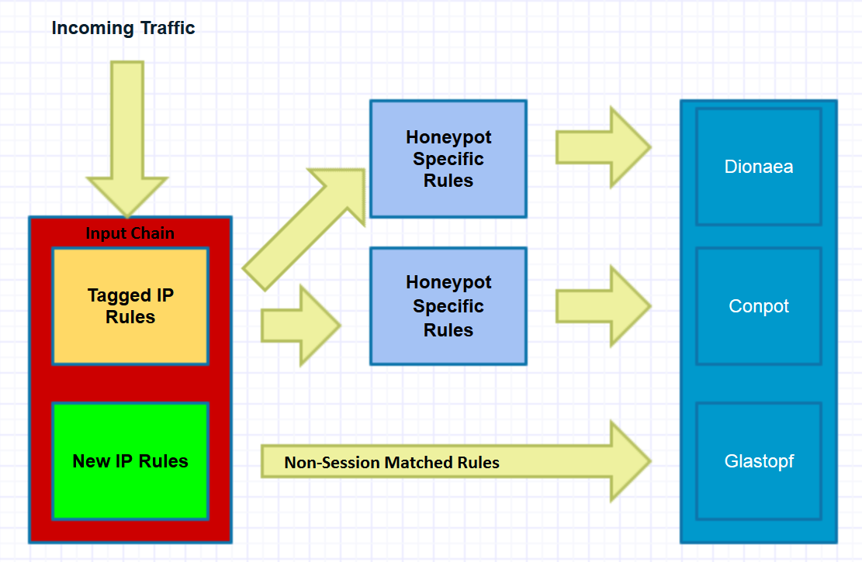
Dynamic IPtables Rules

Slide 18
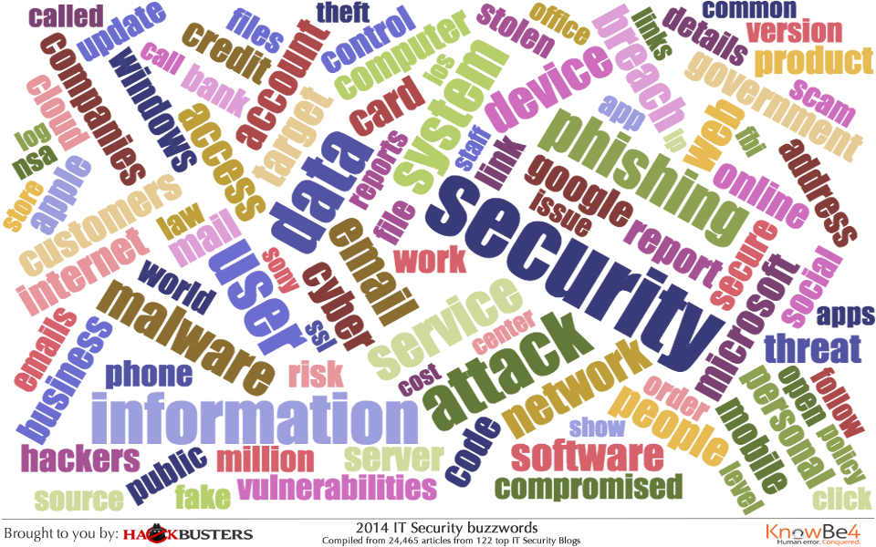
Why It's Important To You
Perimeter Security? Intrusion Detection\Prevention Systems?
Honeypots!
Where the Science is Taking Us in Cybersecurity

Slide 19
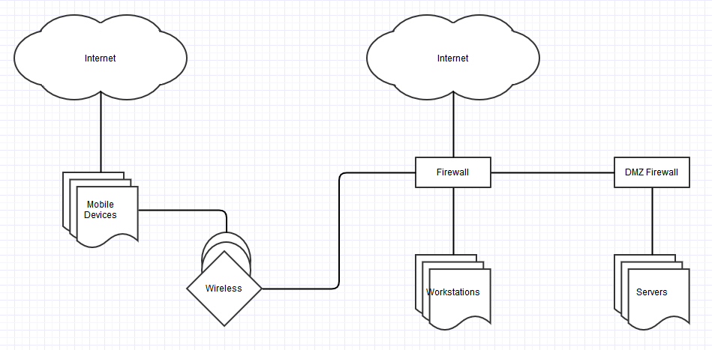
Modern Network Layouts

Slide 20
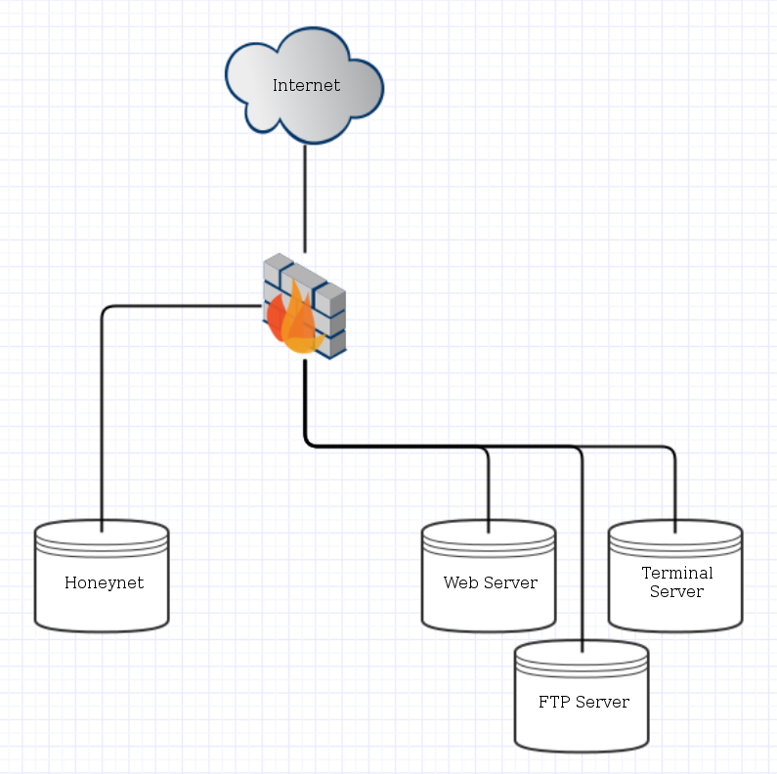
Server Honeypot Layout

Slide 21
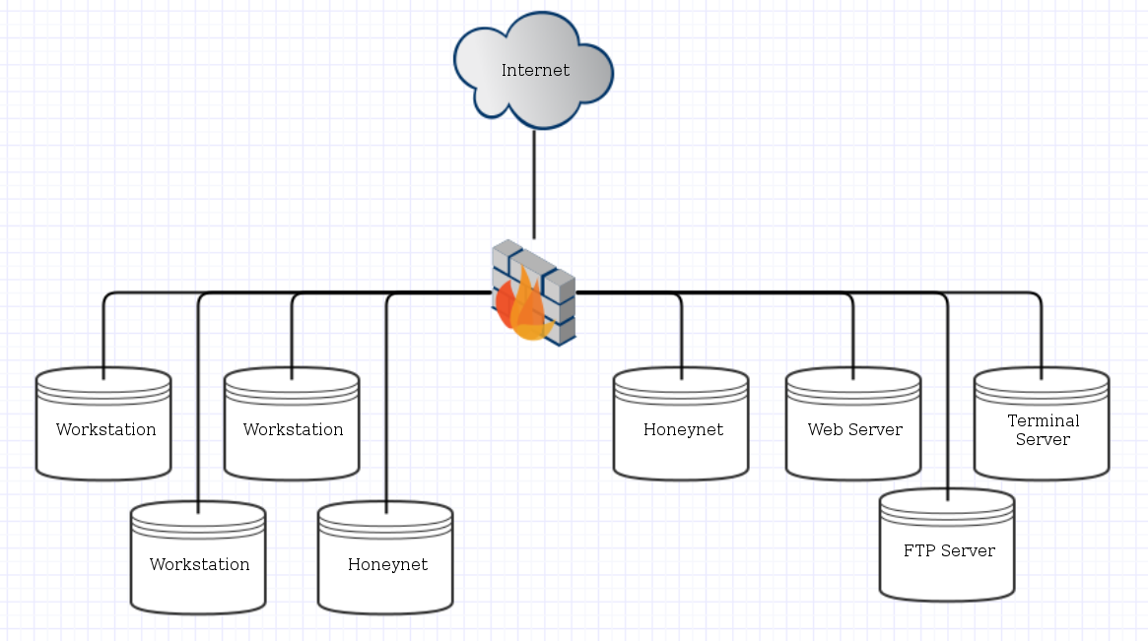
Workstation Honeypot Layout

Slide 22
Plan of Attack
Terminology
Where We've Been
Where We're Going
How Do Honeypots Help Improve Security Posture
How Does HoneyApps Fit in My Org
Videos

Slide 23
Dionaea Honeypot
General purpose honeypot
Expandable through plugins and modules
Full shellcode emulation
Detects attacks on ports:
21(ftp)
69(tftp)
135(emap)
445(smb)
1443(mssql)
3306(mysql)
5060-5061(sip)
63001-64000(ftp)
Automated control and deployment with Director

Slide 24
Dionaea Attacks

Slide 25
Glastopf Honeypot
Web application specific honeypot
Detects attacks on ports:
80 (http)
443 (https)
Full PHP emulated virtual environment
Emulated sql backend
Automated control and deployment with Director

Slide 26
Glastopf Attacks

Slide 27
Conpot Honeypot
Industrial Control Systems(ICS)
Supervisory Control and Data Acquisition (SCADA)
Defaults to building device control system
Full Shellcode emulation
Detects attacks on ports:
80 (http)
161 (snmp)
503 (modbus)
Automated control and deployment with Director

Slide 28
Conpot Attacks

Slide 29
Kippo Honeypot
SSH specific honeypot
Full virtual shell emulation
Daemon attack emulation
Detects attacks on port:
22 (ssh)
Automated control and deployment with Director

Slide 30
Kippo Attacks

Slide 31
RDPy Honeypot
Remote Desktop Protocol honeypot and mitm
Record & replay screen, mouse interaction, and keystrokes
Man-in-the-middle to live Windows hosts
Detects attacks on port:
3389 (ms-rdp)
Automated control and deployment with Director

Slide 32
RDPy Attacks

Slide 33
Thug Honeypot
Low interaction honeyclient
W3C DOM compliant
Google V8 Javascript Engine
Libemu\Pylibemu shellcode emulation
8 IE, 15 Chrome, 3 Firefox, & 5 Safari user-agents and personalities
No active ports, is feed uri's to connect and analyze
Automated control and deployment with Director

Slide 34
Thug Attacks

Slide 35

Conclusion & Questions
Personal:
@c0mmiebstrd
Docker.com/u/sreinhardt – Docker.com/u/commiebstrd
Github.com/commiebstrd – github.com/commiebstrd
HoneyApps:
@honeyappsproj
Docker.com/u/honeyappsproject
Github.com/honeyappsproject
www.honeyapps.net

